Slide 1
Sprint 4
Matt, Andrew, and Estania

Slide 2
Overview of Presentation
01
02
03
Team Roles
Sprint 3
Challenges, ChaNges, & What We learned

Slide 3
Common Roles
Test and Build Code
Complete System Design Document
Document Testing
Collaborate with all other members

Slide 4

Andrew
Individual ROle
Project Manager

Slide 5
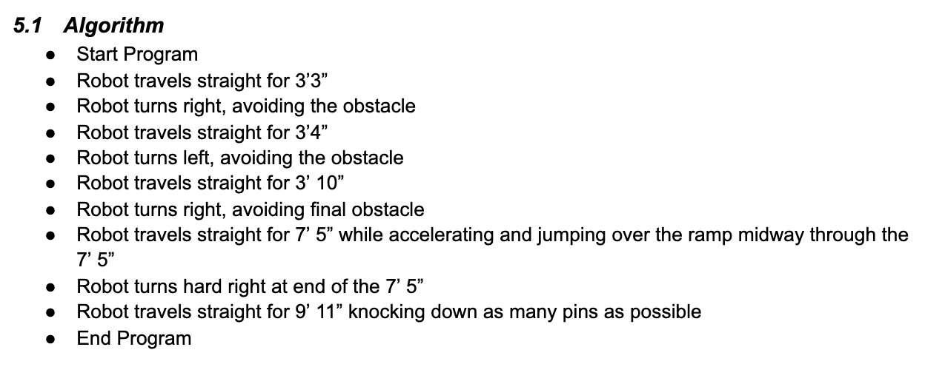
Matt
Individual ROle
Algorithmic Design based on requirements
Used to build the base code

Slide 6
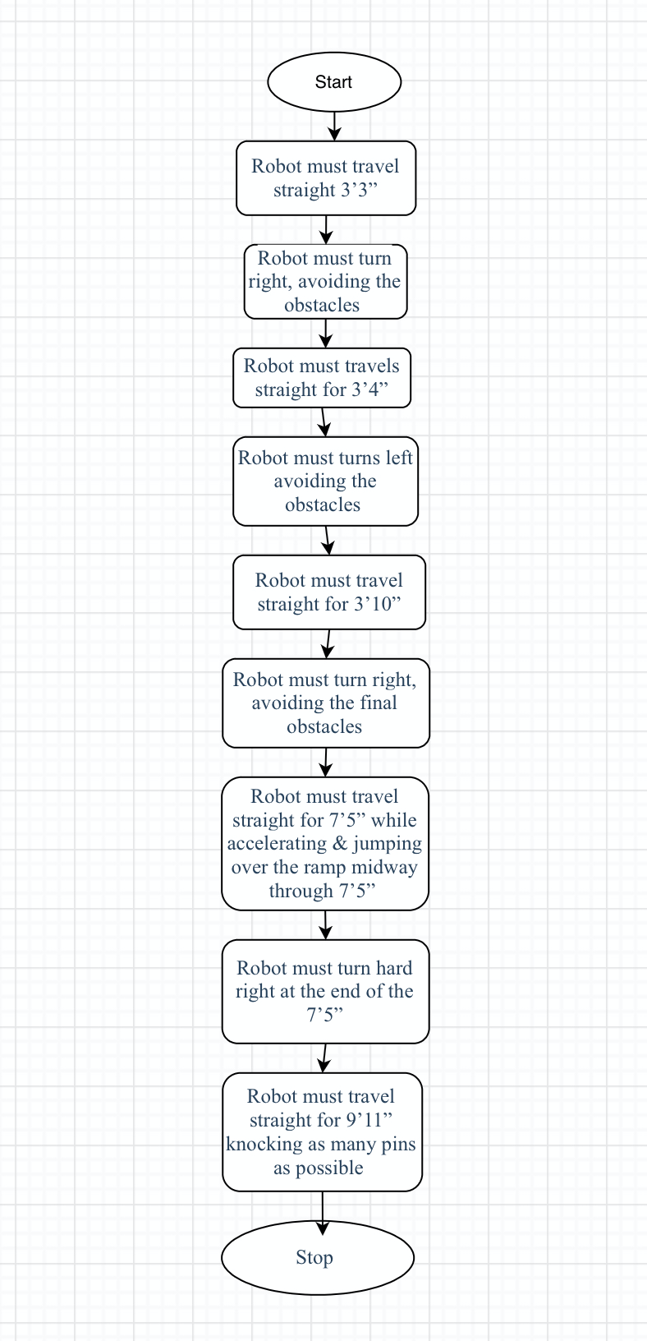
Estania
Individual ROle
The flowchart is based on the requirement table.

Slide 7
SPrint 3
Agility
Block Code and Videos

Slide 8
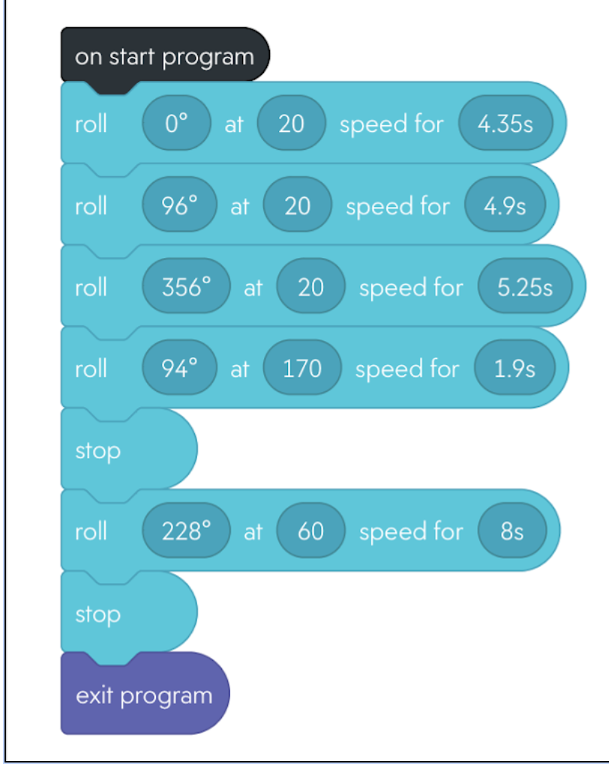
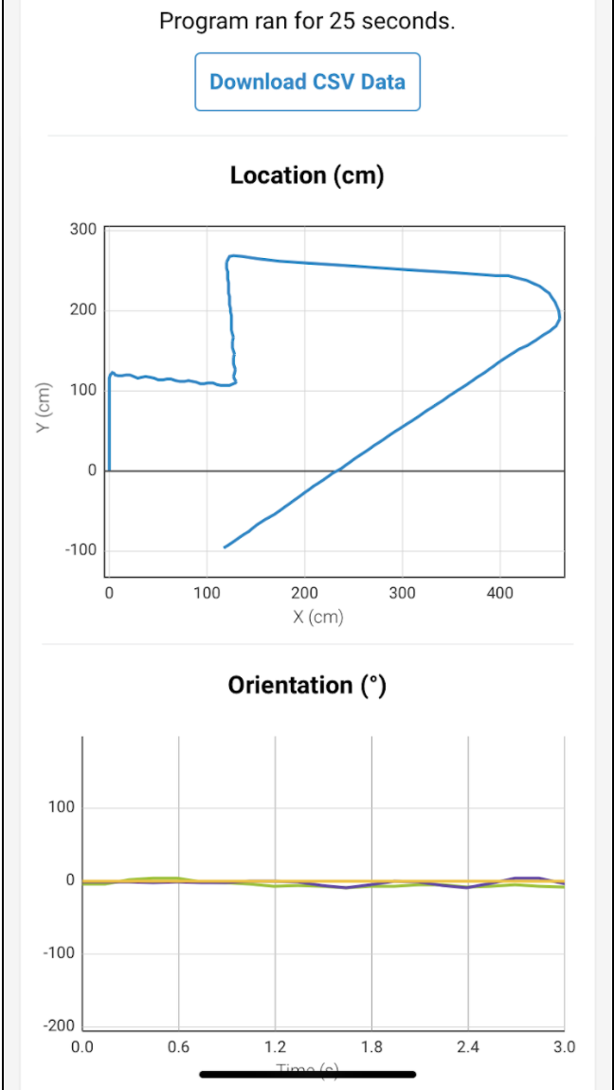
Block Code and Sensor Data

Slide 9

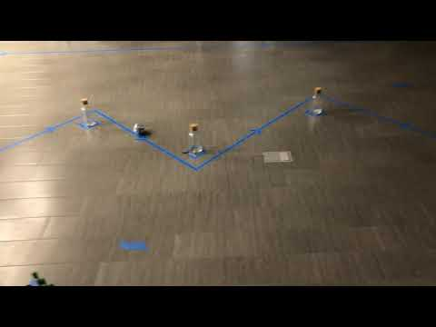
Sprint 3 - Video
https://www.youtube.com/watch?v=aKSfd4w6F7E

Slide 10
CHallenges We Faced
RObot Variability
Technical Difficulties
TESTING Guidelines
System Design Document

Slide 11
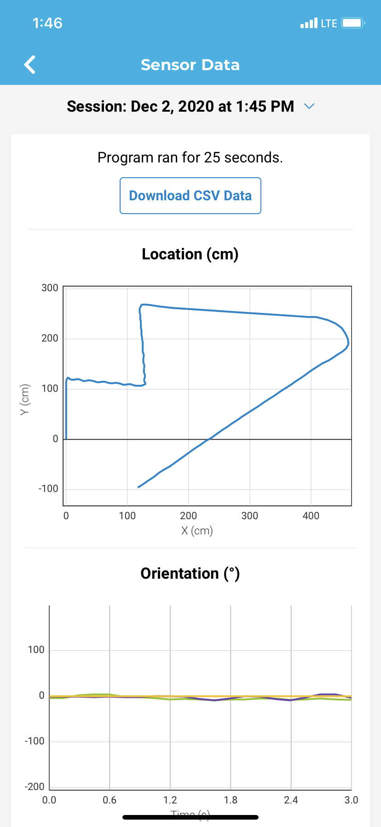
RObot Variability
Same code, different results
Things on the floor
Tape interference

Slide 12

TEchNical Difficulties
Computer connectivity
Lack of sync between phone and computer
Difficulty editing code on phone

Slide 13
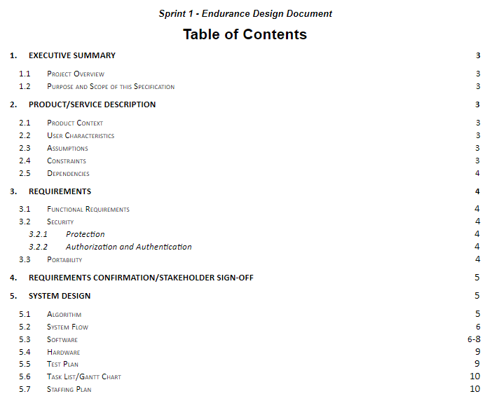
System Design Document
Filling in the Less Specified Sections

Slide 14

Testing guidelines
Covid risks
Robot sign out
Robot testing sign up

Slide 15



Changes We WOuld Make
Research
Accuracy
Time Management
Further Research Previous Sphero Programs
Focus On Precision of Movements
Continuous Work on System Design Document

Slide 16
What we Learned About Software Engineering
Trial and Error
Continuous Process
Take into Account all Requirement and Perfect Them
Code is Constantly Evolving
Teamwork
Planning
All Members Must be on the Same Page
Plan Ahead with Gantt Chart
Effective Communication

Slide 17

THANKS!

